Slide 1

Fantastic Voyage (Inside the Human Body)
By
Hari Priya Chakati
Rahul Reddy Edurinte
Sai Akhil Kondaveti
Sai Teja Parisha
Tejaswi Kommareddy

Slide 2
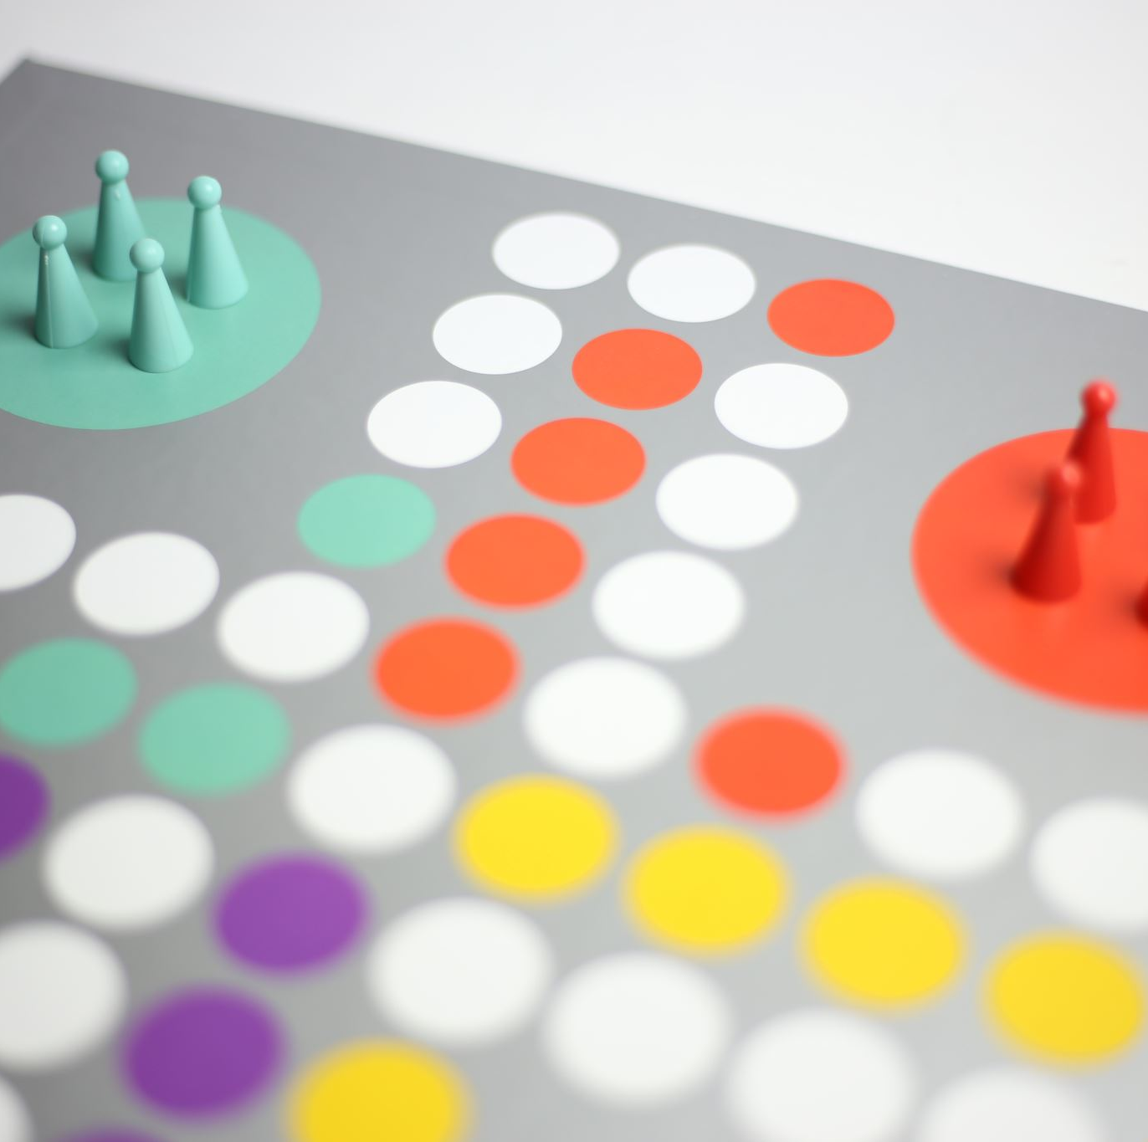
Agenda
Introduction
Game Moto
Game Process
Structure
Game Statistics
Visualizing
Code explanation
Conclusion

Slide 3

Introduction
The code implements a simplified version of the Arteries and Veins flow game.
We will explain the code step by step to help you understand it
It uses the Princeton Algorithms Library (algs4) for various functionalities.

Slide 4
Game Moto
Recreation
Best Indoor Game
Technology friendly
Children accessible
Unlimited Attempts

Slide 5
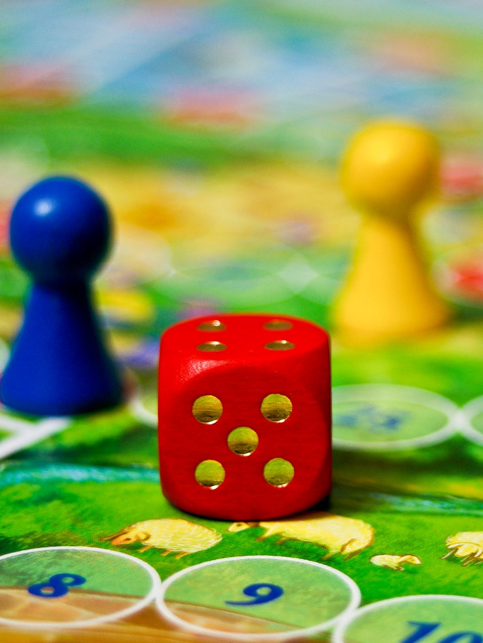
Game Process
Game is Human body themed upside-down game.
It has 1-4 players
It has winning point at 81
It has both Arteries and Veins which makes game exciting
6-sided dice

Slide 6
Structure
Libraries:Algs4
Organization: includes all classes and Methods
Approach: Through Different color player, GUI, StdDraw
Coordinates: to represent grids

Slide 7
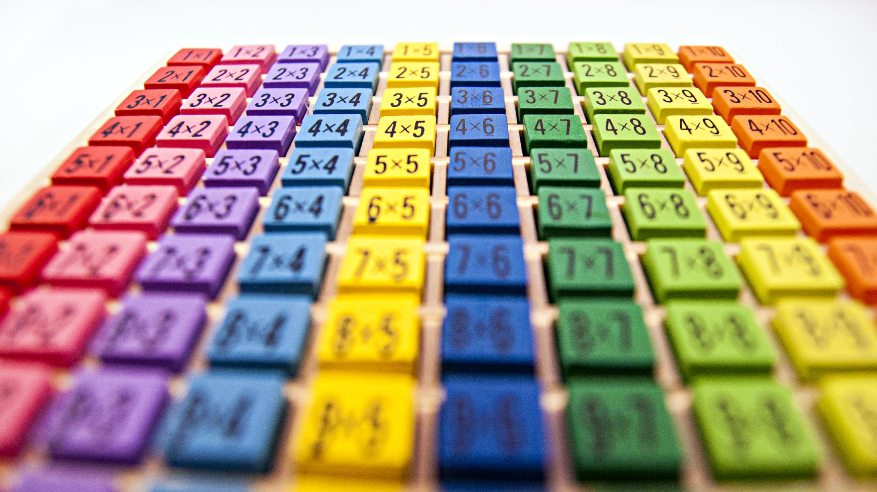
Visualization
It has 81 spaces
Player mover according to the dice
Used StdDraw library for visualization
Used different colors to represent players

Slide 8
Game Statistics
Total die rolls for game
Total die rolls for each player
Most common die rolls for a players
Total veins for a player
Total veins for overall game
Total Arteries for a player
Total Arteries for overall game

Slide 9
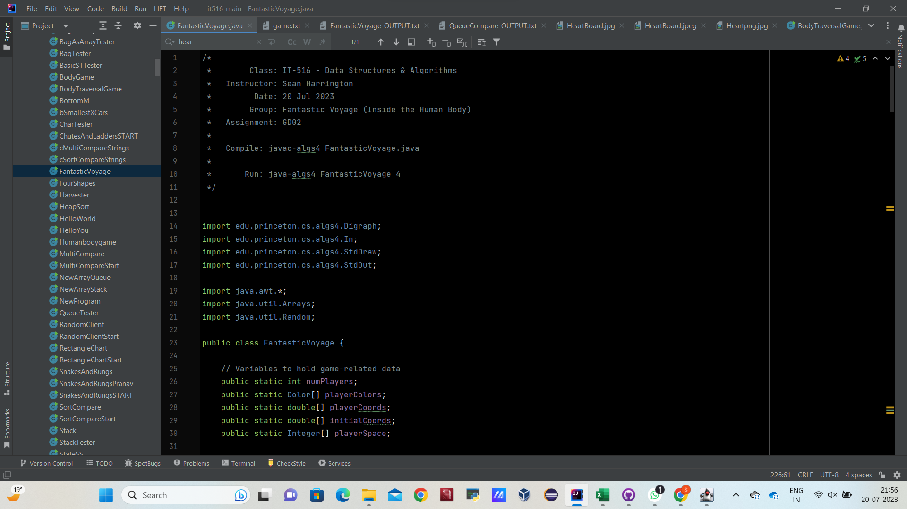
Code :

Slide 10
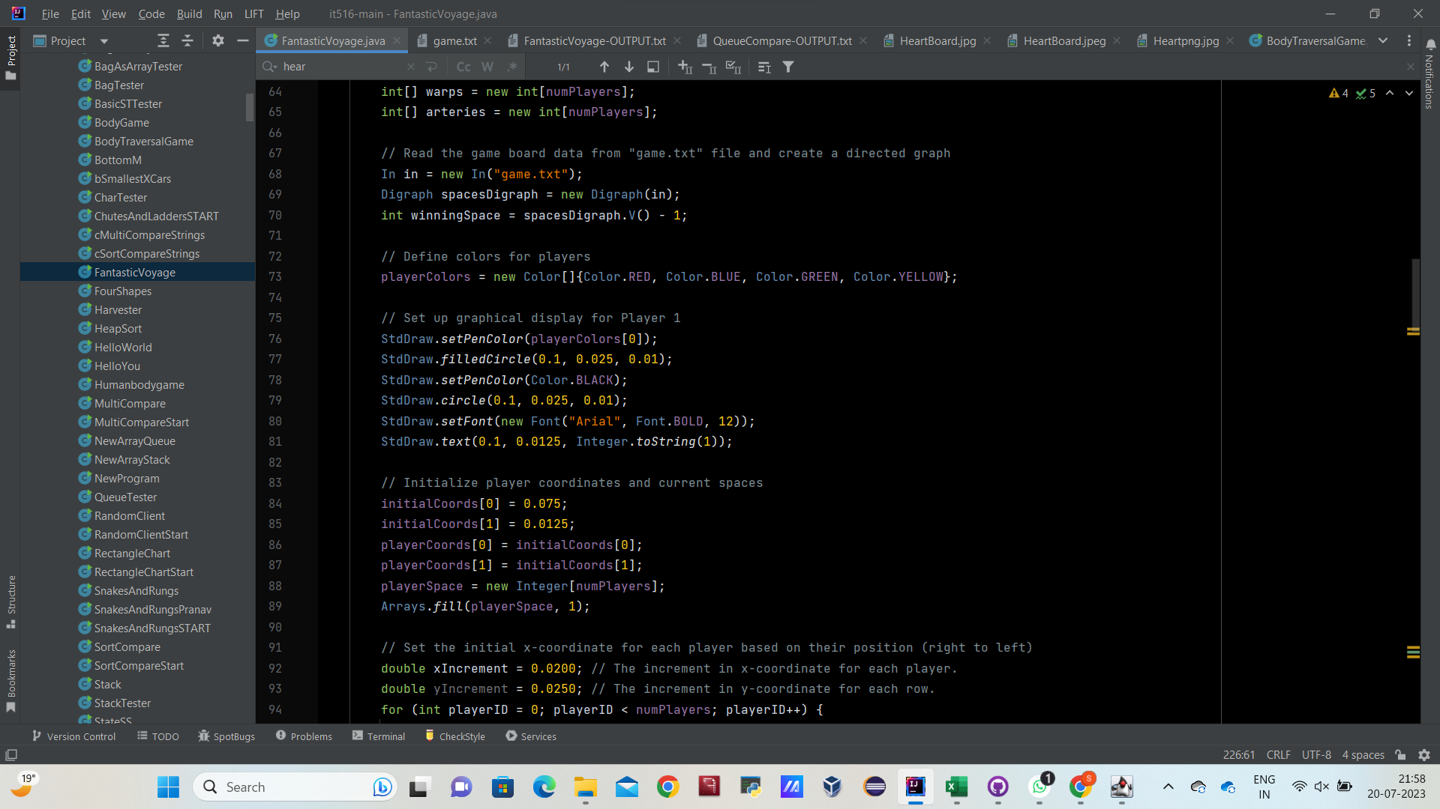
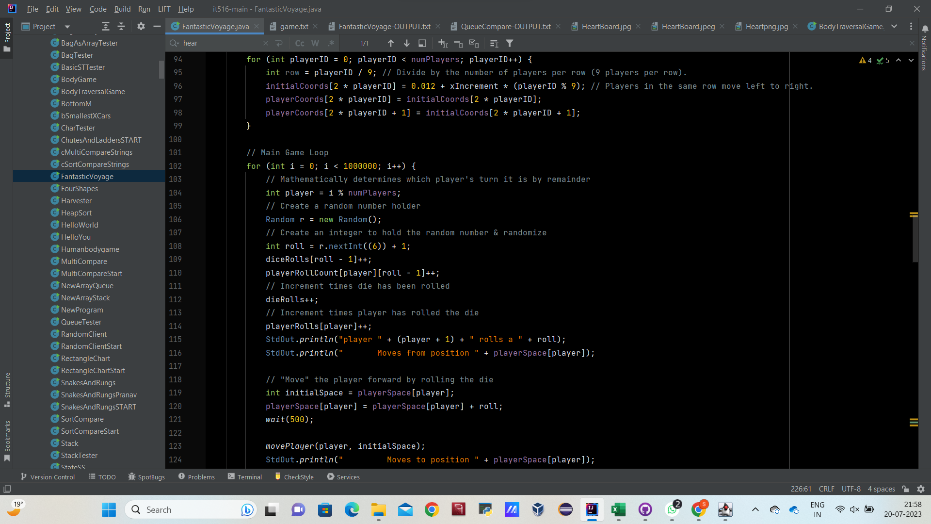
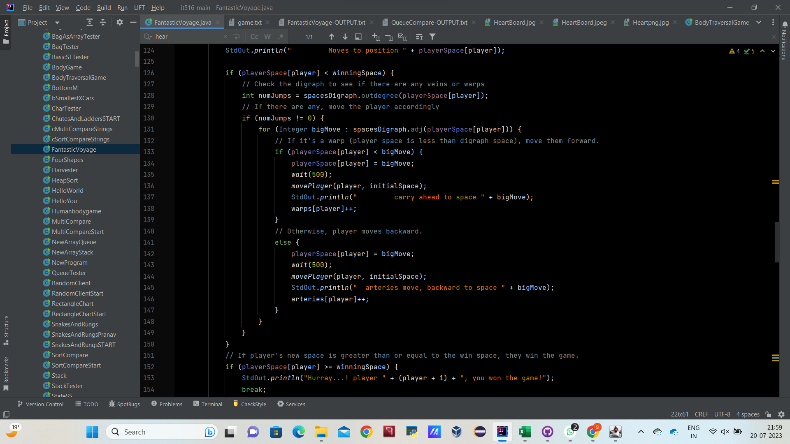
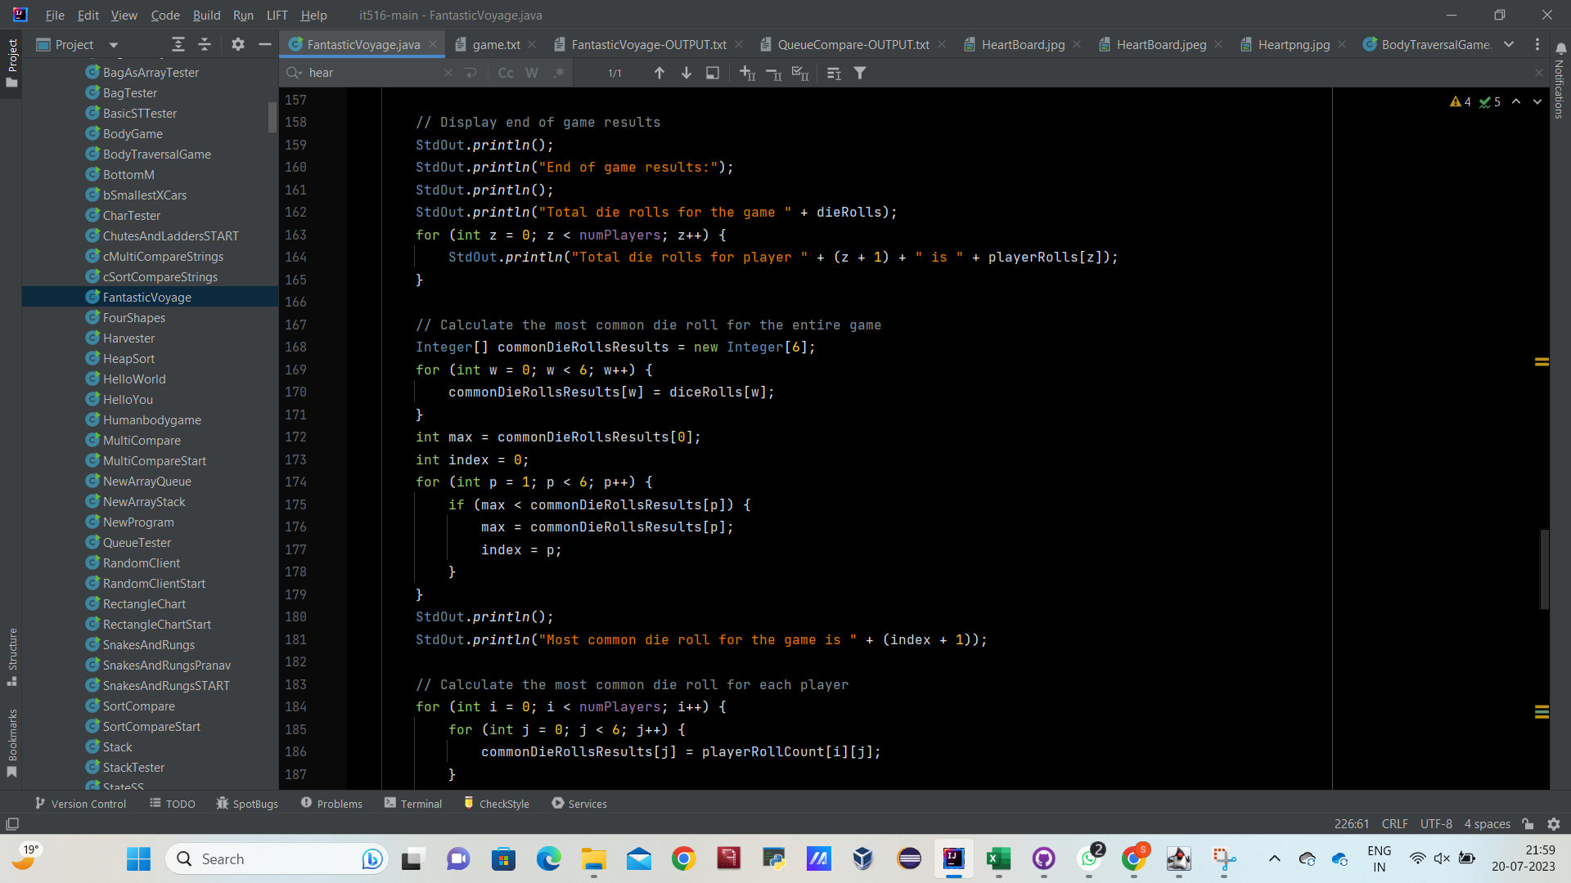
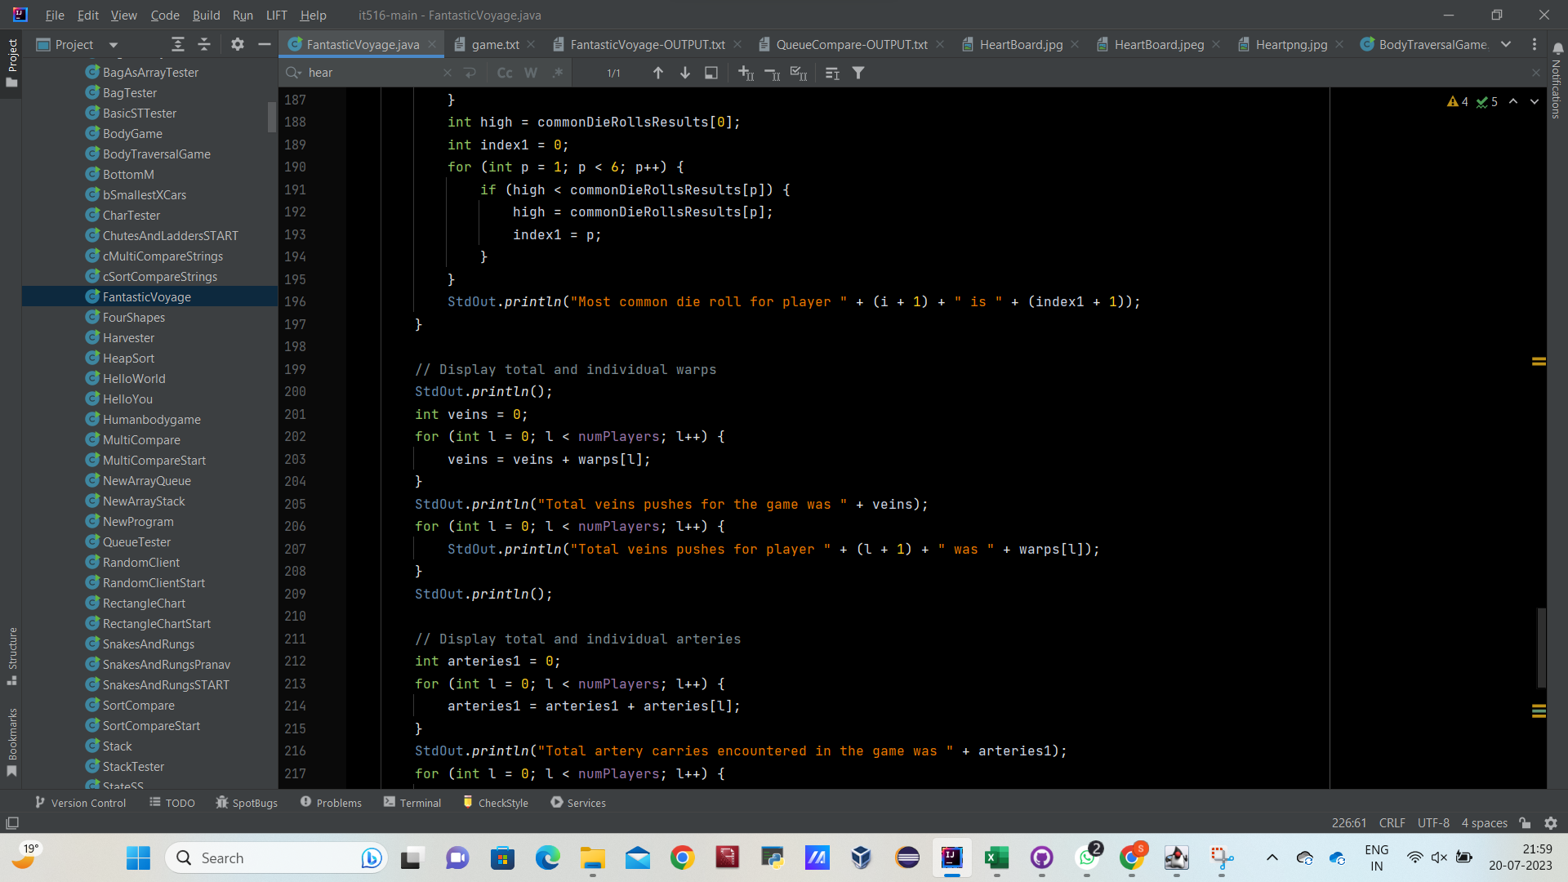
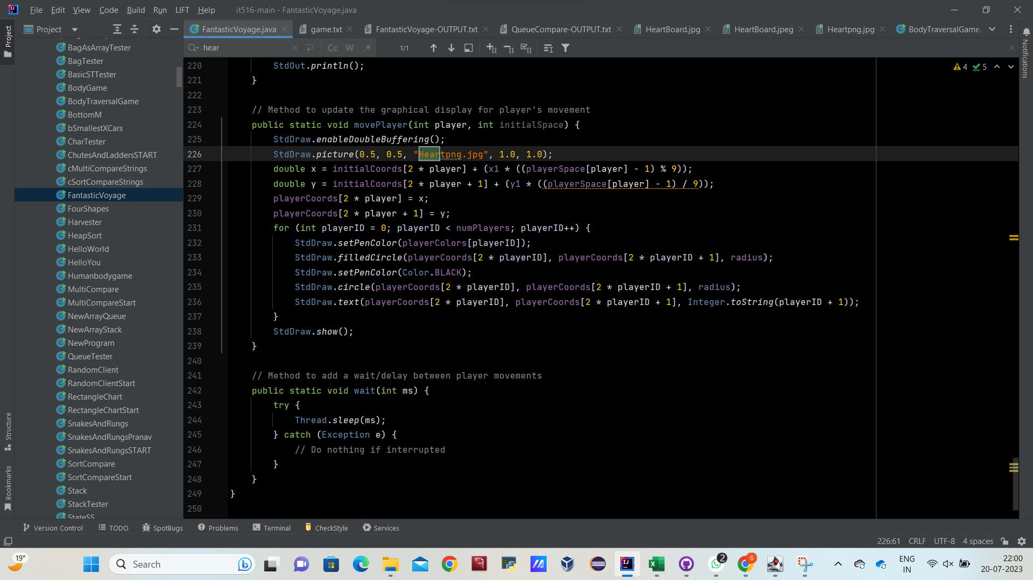
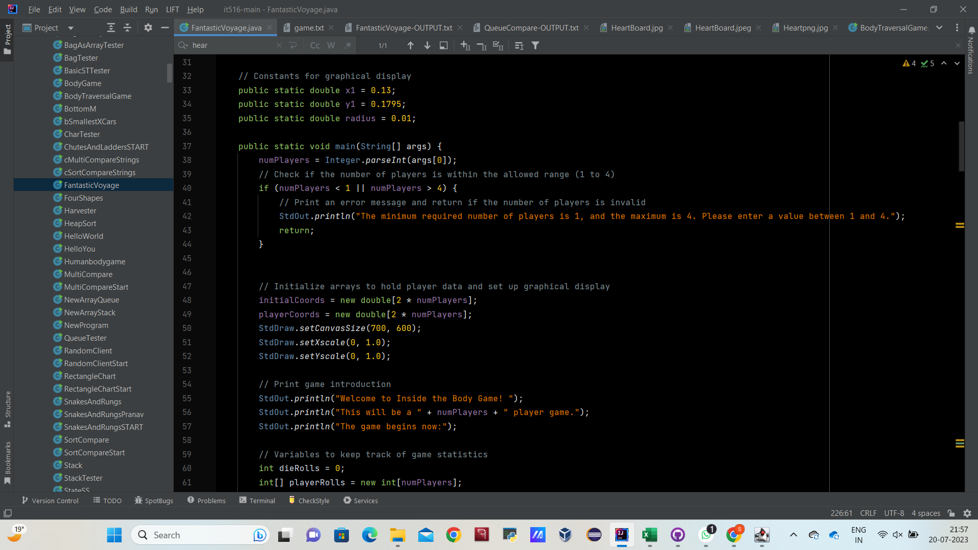

Slide 18
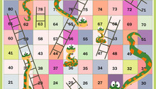
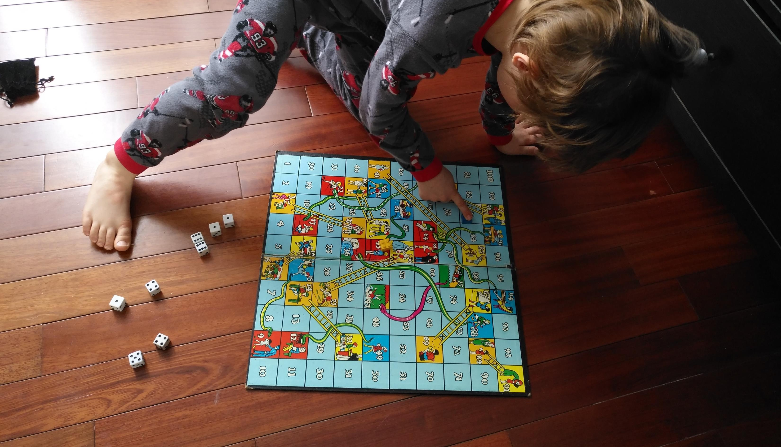
Conclusion
The real Implementation of Fantastic Voyage with GUI, StdDraw from Princeton libraries and java is used for the development.
You can enjoy unlimited attempts of the game.

Slide 19

THANK YOU

